Slide 1

CEH Project
Prof Drew Gansmiller
Elisha Ngwana (TAMUK QuikStart Student)

Slide 2
CEH Project Tasks
Scan a network & hosts to find vulnerabilities.
1
Exploit vulnerabilities found in production server.
2
Document and explain the process,
3

Slide 3
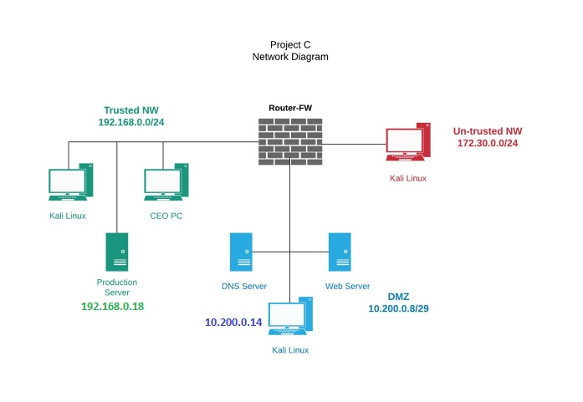
Network Topology
Production Server added to Trusted NW
Trusted NW – CEO PC, Kali, & Production Server.
DMZ – DNS server, Kali, & Web Server
Untrusted NW – Kali
Three-faced Stateful Firewall

Slide 4
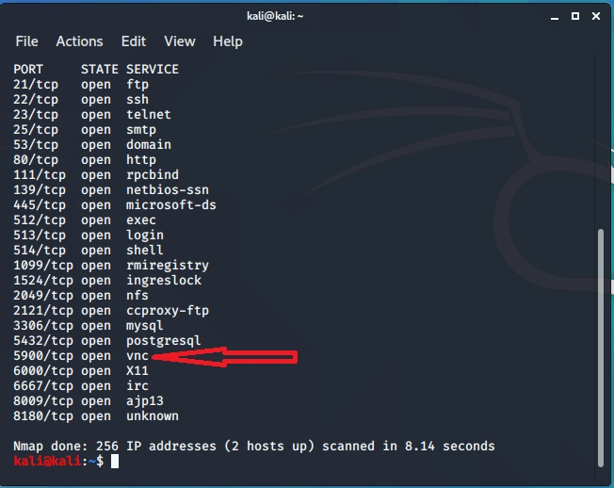
Tools & commands for scanning vulnerabilities
Nmap 192.168.0.* (wildcard) - Image
Nmap -A -T4 192.168.0.18 for services on hosts
Nmap 10.200.0.9/32 for all host on network range
Nessus to enumerate entire network and hosts
Metasploit to exploit vulnerability
Netscat to establish remote connection btw 2 systems

Slide 5
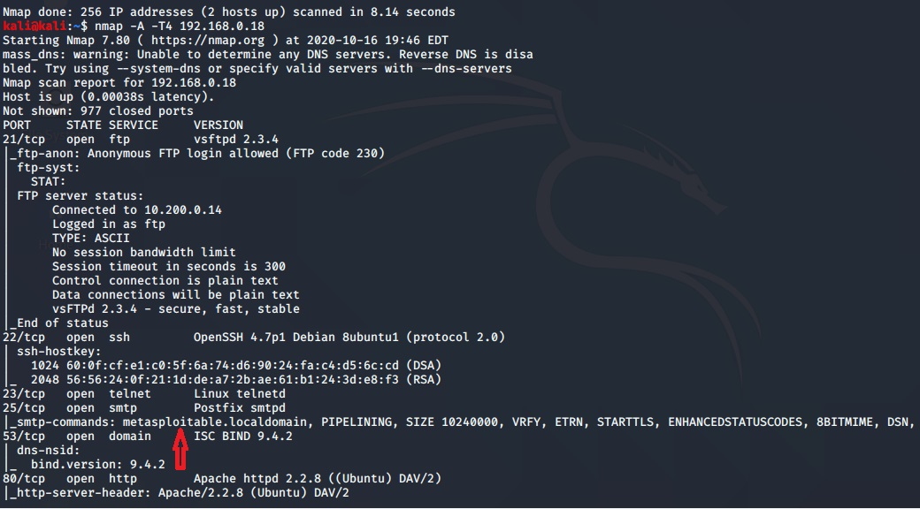
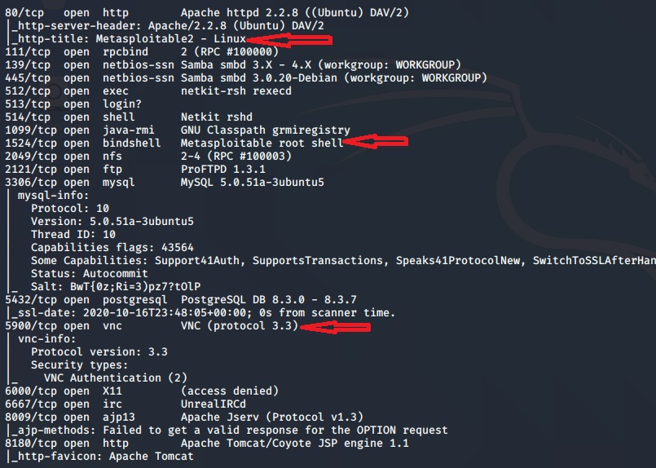

Slide 6
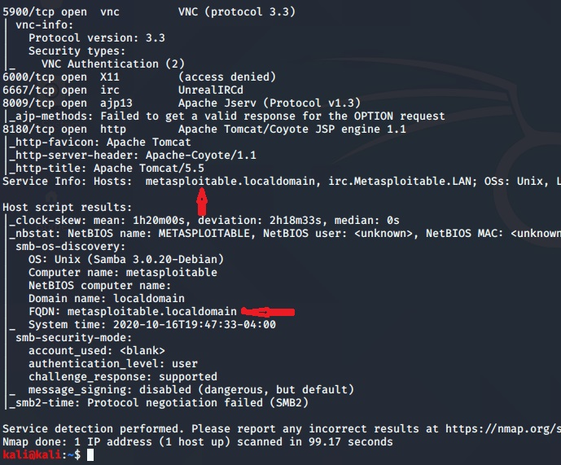
Vulnerabilities
VNC TCP/port 5900
NetBIOS (metasploitable)
Shell (CVE 9.3) CVE -2012-1527/1528
Blindshell (metasploitable) TCP/ port 1524
SMTP (metasploitable) TCP/port 25
http TCP/port 80 (metasploitable)

Slide 7
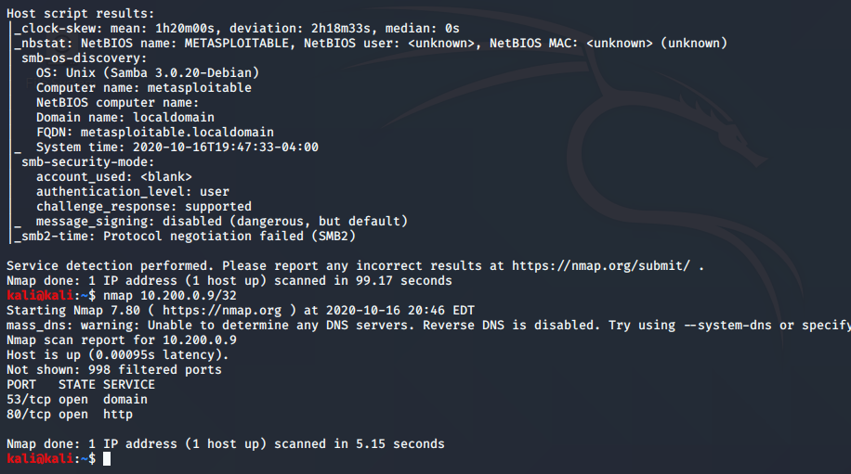
Systems info
Attack System = Kali @ DMZ 10.200.0.14 TCP ports 53 & 80
Victim System = Production Server 192.168.0.18 @ Trusted NW
OS = Unix / multiple open exploitable ports
Tool = METASPLOIT

Slide 8
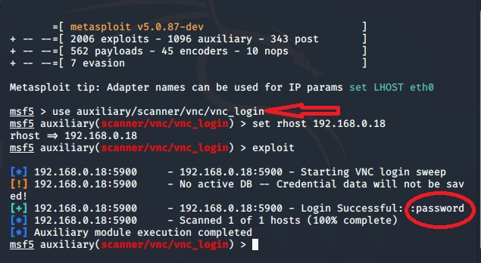
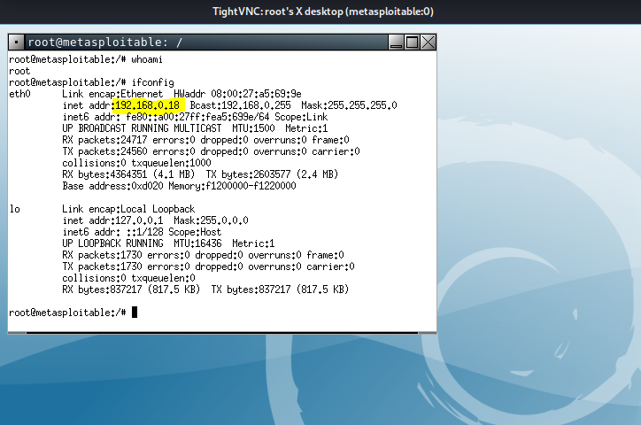
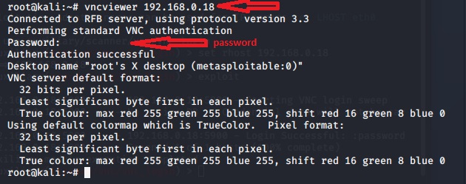
VNC auxiliary command
VNC password
Hacked Production Server

Slide 9
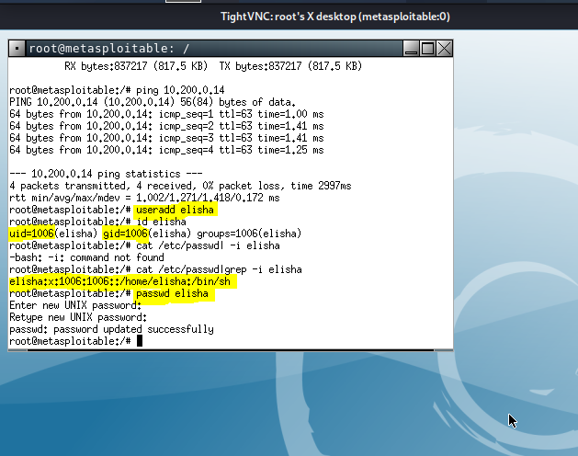
New User created on Production Server
#useradd Elisha
#id Elisha
User id: 1006
Group id: 1006
#cat /etc/passwd|grep –i Elisha
#passwd
= quickstart

Slide 10
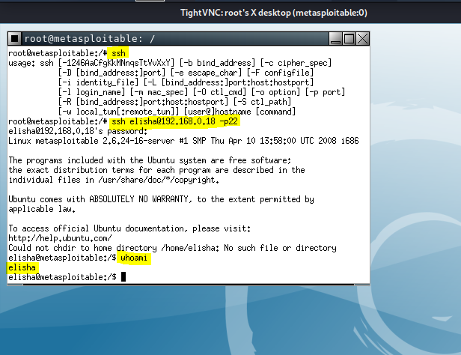
Whoami command via SSH port 22
#ssh (to check Secure shell is installed)
#ssh elishs@192.168.0.18 -22 (open SSH link)
#whoami = Elisha
(to confirm new account access)
SUCCESS!

Slide 11
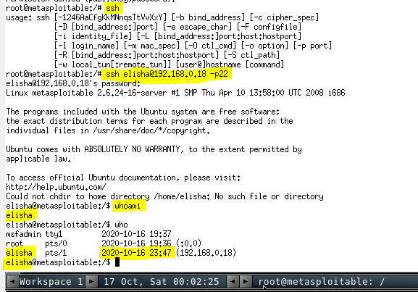
Production Server User Accounts
Msfadmin
Root access
Elisha (new)

Slide 12
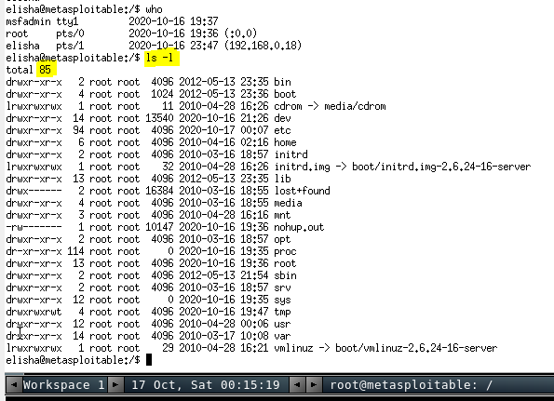
Files on the Production Server
85 files
Different user priviledges

Slide 13
Thank you
End

